Slide 1



Sales Dashboard
View in Power BI
Last data refresh:
3/16/2022 10:57:15 PM UTC
Downloaded at:
3/16/2022 10:59:00 PM UTC

Slide 2
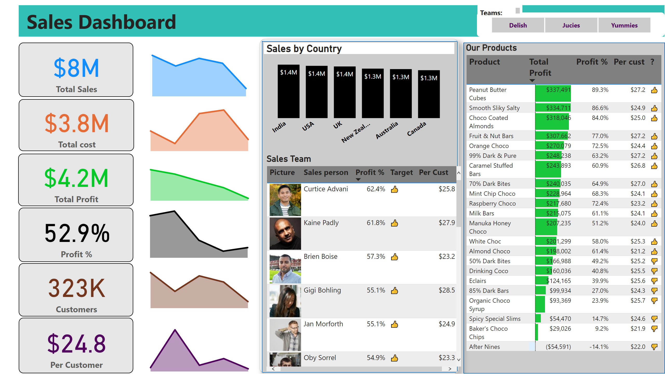
Sales Dashboard
Notes:
card
No alt text provided
slicer
No alt text provided
textbox
No alt text provided
card
No alt text provided
card
No alt text provided
card
No alt text provided
areaChart
No alt text provided
areaChart
No alt text provided
areaChart
No alt text provided
areaChart
No alt text provided
Sales Team
No alt text provided
Our Products
No alt text provided
textbox
No alt text provided
shape
No alt text provided
Sales by Country
No alt text provided
card
No alt text provided
card
No alt text provided
areaChart
No alt text provided
areaChart
No alt text provided
shape
No alt text provided

